Slide 1
Software product management
Core concepts
Joydeep Barman

Slide 2
Contents
Principles of product management
Characteristics of a holistic product
Product-Market fit vs Product Vision
Problem space vs Solution space
User vs buyer
Continuous discovery and delivery
Product eco-system
Critical success factors
Evaluate your product

Slide 3
Principles of product management
Establish compelling value. Examples:
  MakeMyTrip – a one stop shop for travel,
  Postman – Make API testing easy
Many of our ideas won't work out, and the ones that do will require several iterations. Examples:
  Slack - Initially they developed a multi-player online game which did not succeed, but the inbuilt messaging feature became successful.
  MakeMyTrip initially targeted Indian travellers, but was not successful. Later targeted NRIs
We must validate our ideas on real users and customers. Examples:
  Bounce – Validated the ‘Rent-a-bike’ idea by investing in a few scooters
  AirBnB – Rented their apartment to conference attendees
Validate ideas fast and with minimal cost – the more we delay, we may be expending more effort & cost on an idea that does not have a market.
Have you experienced any of these principles?

Slide 4
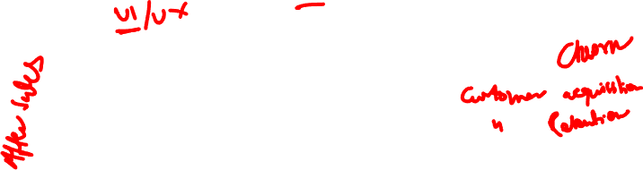
Different aspects of a product
Functionality: Example booking tickets is one function of MakeMyTrip
Technology: Example: Microservices architecture used by Amazon, Encryption used by WhatsApp, AI/ML used by Logically
User experience (UX): Example Tally’s ease of use for non-finance people
How do we monetize?: Example through transaction fee of Payment gateways or subscription fee of SalesForce
How we attract & acquire customers? Example: Freemium of Zoom, cash back of Paytm, Search Engine Optimization, Ads
Offline experience: Example: Merchandise fulfilment experience and merchandise return experience of Amazon & FlipKart, support experience by call center personnel, self help material on website

Slide 5
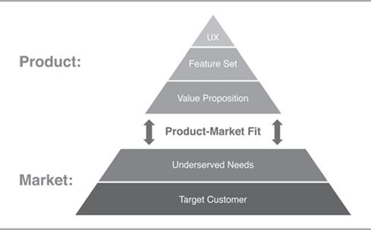
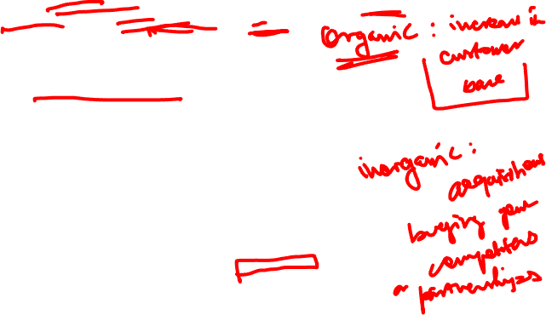
Product-Market fit
It is about how well the product meets the needs of the customer (market)
Good Product/market fit results in happier customers, lower churn rates, shortened sales cycles, and rapid organic growth. (Inspired)
You can always feel when product/market fit isn't happening. The customers aren't quite getting value out of the product, word of mouth isn't spreading, usage isn't growing that fast, press reviews are kind of "blah", the sales cycle takes too long, and lots of deals never close.

Slide 6
Product-Market fit
Marc Andreessen coined the term product-market fit in a well-known blog post titled “The only thing that matters.” (https://pmarchive.com/guide_to_startups_part4.html)
In a great market -- a market with lots of real potential customers -- the market pulls product out of the startup. Example
  eCommerce, EdTech, FinTech
Conversely, in a terrible market, you can have the best product in the world and an absolutely killer team, and it doesn't matter -- you're going to fail. Example:
  Video conferencing (2007), Iridium satellite phone
  Do you know of any great product that failed?
Great products sometimes create huge new markets – examples:
  Virtual machine by VMWare, smart phone by Apple
  Any other?
The only thing that matters is getting to product/market fit.

Slide 7








Product-Market fit vs
Product Vision
The Product Vision…..
Is a guess!
Problem
2 – 5 years
Solution
Product Manager
Target Customer
…. Is an early adopter!
New Product or new opportunity in an existing product:
Assumption 1
Assumption 2

Slide 8
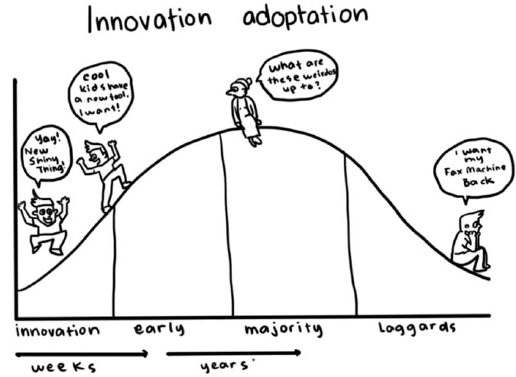
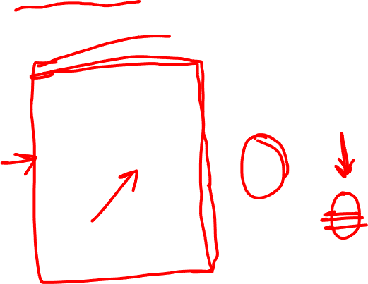
Product-Market fit vs
Product Vision

Slide 9
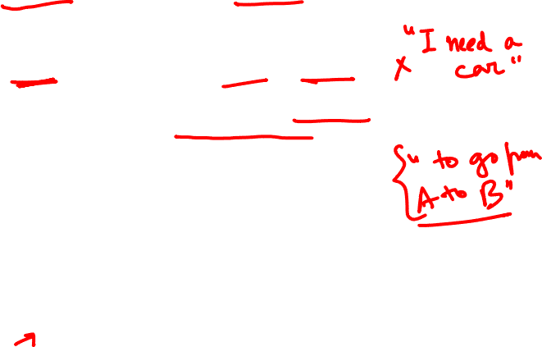
Problem space vs Solution space
Problem space consists of customer needs and pain points.
However problems are not always easy to know:
  Customers express their needs in terms of existing solutions.
  For example they say “I need a cab in 5 minutes”, because they think cab is the only solution
  The real need is to go from A to B.
There can be many solutions for this:
  Hire a cab,
  Use self-driving scooter or car,
  Hail a bike taxi.
  Any other?
Therefore before finding a solution, we need to understand the real need / problem
  Understand what customer needs and why
  Observe what he does, why he does it, etc. (Persona)
  “If I had only one hour to solve a problem, I would spend up to two-thirds of that hour in attempting to define what the problem is.”

Slide 10
Problem space vs Solution space…
What differentiates one product from another is the quality of solution. Examples:
Space pen: Need is to write in space. US designed an ink pen that works in zero gravity. Russians used a simple pencil
Progressive auto insurance: Customer wanted quick settlement of car insurance claim. A process that took 6-7 days was cut down to 1 day through innovative solution
MoveWorks: Users need quick IT support to install say a Project management software. Solutions can be: Raise a ticket, Call IT support, Use MoveWorks bot which will check your eligibility and download the sw & install it instantly
Application maintenance service: Is faster problem resolution the need or zero problem the need
Any other example?

Slide 11
User vs Buyer
In large enterprises the decision makers are not the end users
Decision makers are usually VP and SVP. They want to solve a business problem / pain point.
Their concerns are functionality that brings business value (increase customer satisfaction, customer growth, reduce customer churn), productivity, security, reliability / stability / quality of solution
The end users typically do not have the power to approve the product. But ultimately they are the ones who are going to use the product. Hence it needs to be user friendly, efficient in performing their functions.
Example
  Lotus Notes: It was a very secure team database and Email system. But not very user-friendly.
  Cisco WebEx – very reliable but not very user friendly. But corporates prefer it.
  Do you know of any other examples?
But this is changing with SaaS product. Management is becoming more aware of UI / UX

Slide 12
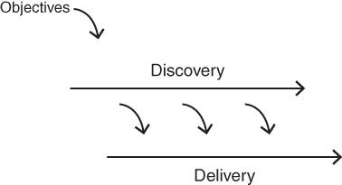
Continuous discovery and delivery
Discovery and delivery are our two main activities on a cross‐functional product team, and they are both typically ongoing and in parallel.
We are always working in parallel - to both discover the necessary product to be built—which is primarily what the product manager and designer work on every day—while the engineers work to deliver production‐quality product.
The engineers are also helping daily in discovery (and many of the best innovations come from that participation, so this is not a minor point), and the product manager and designer are also helping daily on delivery (mainly to clarify intended behavior). But this is what's going on at a high level.
Example Postman, Slack
Does this happen in your product company?

Slide 13
Product eco-system
Product should address the total customer experience (the whole offer)
Kaagaz & MS Office Lens (document scanner app on mobile) does not only scan but allows us to share the image via email, WhatsApp etc. Because the customer is not just interested in scanning and storing, he wants to share with others
Xerox started with photo copying facility but soon realized people need to staple the pages, need cover page in different colour, etc. So they enhanced the machine to address the total customer experience
Clarify: customer support software that involves tracking customer interaction, product details, knowledge base, workflows
NoBroker.com: Find house, pay advance, get painter, get packer & mover
Have you come across other products that address total customer experience?

Slide 14
Product eco-system
Creating Partnerships & alliances
Xerox tied up with paper manufacturers to ensure steady supply of paper
SAP partners: DataXtream for POS solutions, DocuSign for eSignature integration with SAP
Netflix tied up with telecom service providers such as Verizon, Airtel to host their content at ISP gateways, so as to ensure fast response time to customers
MakeMyTrip built alliances with Airlines, hotels, etc.
Any other examples you have come across?

Slide 15
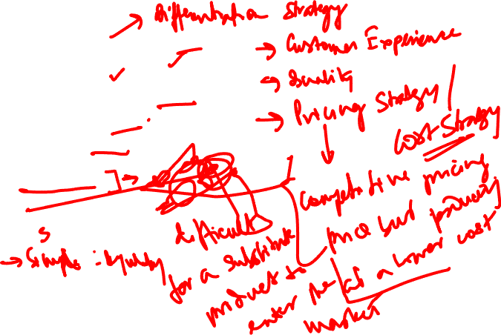
Critical success factors
Differentiation
  Intuit – UI and features
  Apple – UX
  Citibank– Reliability & infrastructure
  .Net – Ease of use
  Toyota – Quality
  ISRO – low cost satellite launches for world-wide customers
Entry barrier
  Google Earth – Entry barrier due to technology
  Da Vinci Robotic surgery – Technology
  Microsoft HoloLens – Mixed reality technology for doctors, etc

Slide 16
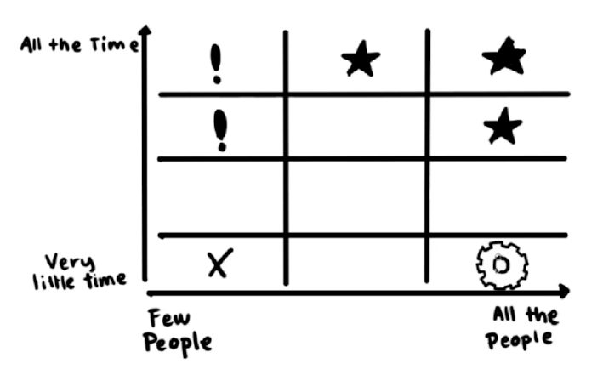
Evaluating your product
The Feature Audit

Slide 17
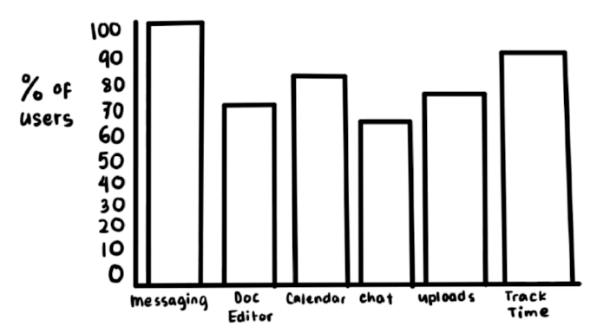
Evaluating your product
Ideal Feature Usage

Slide 18
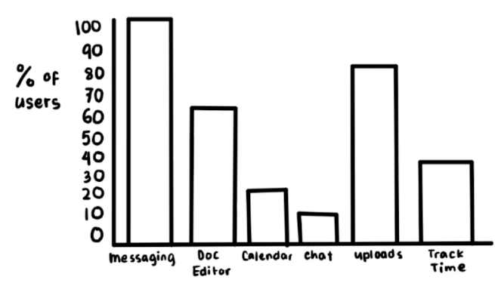
Evaluating your product
Actual Feature Usage

Slide 19
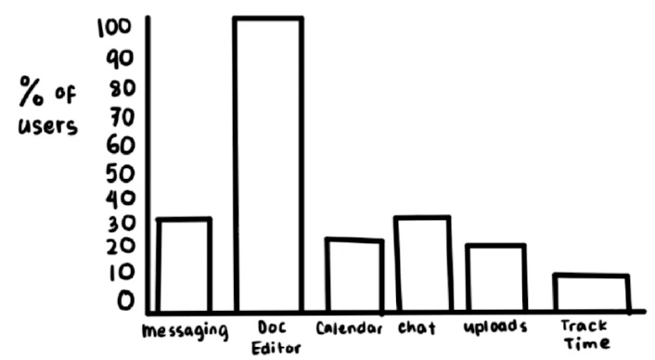
Evaluating your product
At risk of disruption

Slide 20
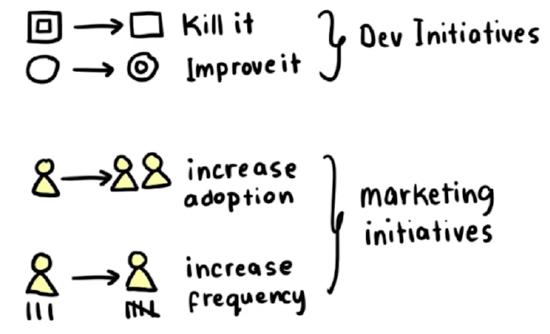
Evaluating your product
Actions to be taken:

Slide 21
Assignment Method:
This is a Group Assignment
Each Group is expected to pick a Tech product of their choice (welcome to select a new idea/ product)
Each class we will learn something new in the course and an exercise pertaining to that class learning will be given as a part of the assignment case study
I have also picked up a product case study (Uber – no other group is allowed to select this ☺) which I will explain in each session based on the class learnings throughout the course. This is like me doing the assignment and sharing it as an example to better explain to the class
Also in each session, a student group may present an exercise from the past two weeks and how they have applied their learnings on their specific product case study assignment
No student group will be repeated for presentation.
These presentations will be evaluated and will contribute to your assignment marks (5% of total weightage over and above your assignment weightage). That is if you get 23 out of 30 in assignment but as you have given a presentation so bonus 5 marks will be added making it 28 out of 30. However, maximum marks can not go over 30.
This will help you to consistently learn and apply your learnings through the course, and help your fellow colleagues/ classmates to share any feedback immediately
Presentation would be very brief (typically 5-10 mins long including any Q&A)

Slide 22
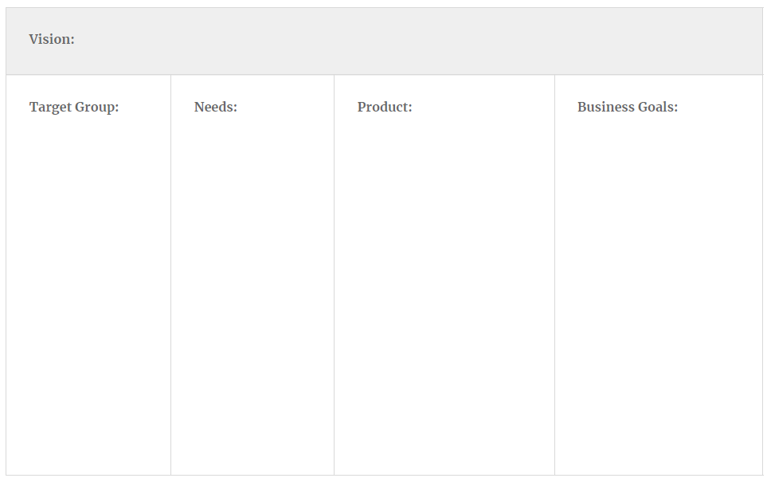
Exercise 2a: Product Vision
We are a tech company that connects the physical and digital worlds to help make movement happen at the tap of a button. Because we believe in a world where movement should be accessible. So you can move and earn safely. In a way that's sustainable for our planet.
PASSENGER
Professionals with
smartphones
DRIVER
- Taxi drivers with
smartphones
- Anyone with a
reliable car, good
driving record &
smartphone
PASSENGER:
- Fast
- Cheap
- Clean
Safe
DRIVER
- Safe
- Flexible
- Start now
- No upfront costs
- Little training
PASSENGER:
- App on iOS
- View driver profile
- One click booking
- View driver location
- One click pay
- Rate driver
DRIVER
- App on iOS
- View passenger profile
- View passenger location
- One click accept
- Turn by turn navigation
- View earnings
- Get paid
SHORT TERM
- Find product market fit
MEDIUM TERM
- Expand from San Francisco to all of the US
LONG TERM
- Go global

Slide 23
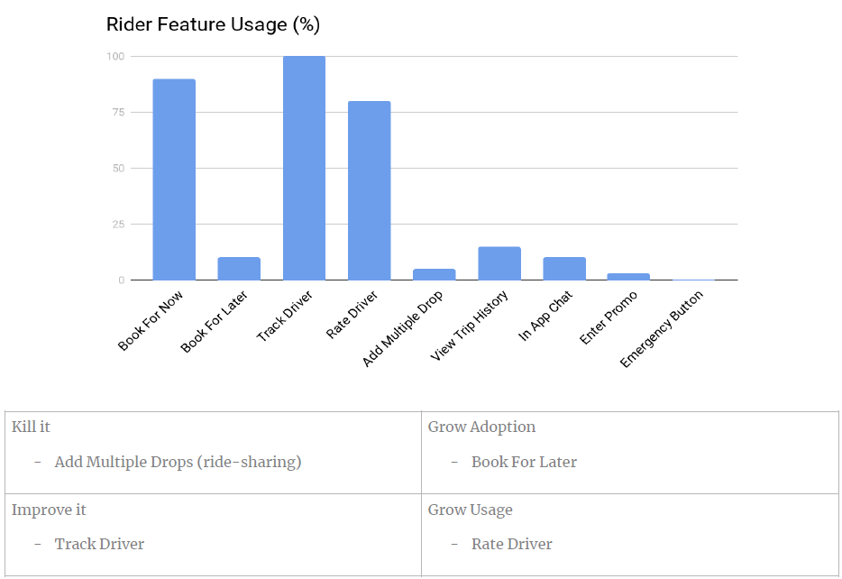
Exercise 2b: Feature Audit

Slide 24
Exercise 2a: Product Vision

Slide 25
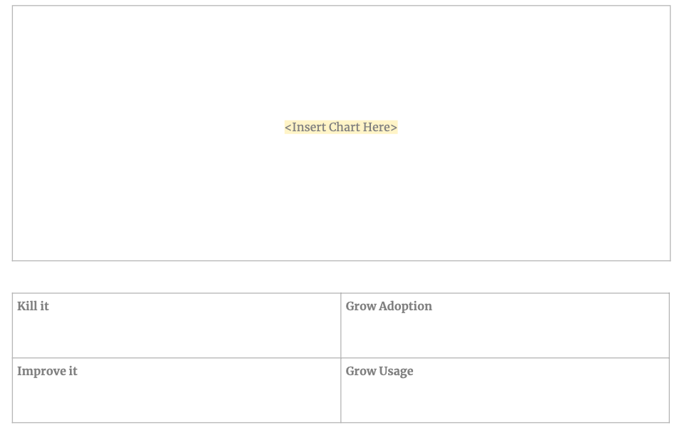
Exercise 2b: Feature Audit

Slide 26
Thank You!

